Slide 1
Modelling, Simulation, and Implementation of Linear Control for Asymmetric Multirotor Unmanned Aerial Vehicles
Akinola Alexander Dada

Slide 2
Background
Unmanned Aerial Vehicles (UAVs) aerial systems not directly controlled by humans onboard.
Focus on multirotors
Wide ranging applications
Dynamically unstable thus require control systems

Slide 3
Aims and Objectives
Basic Objectives
Advanced Objectives
Develop multirotor mathematical model
Develop LQG control
Develop a simulation
Propose flight control software
Discuss the results
Investigate LQ-MPC in simulation
SARSCOVID-2
No flight control software Implementation and testing

Slide 4
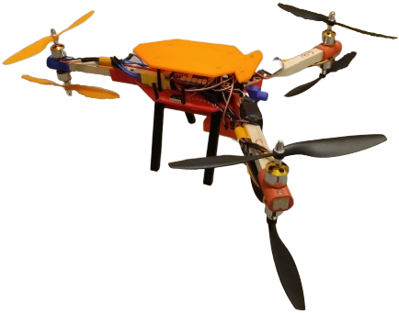
UAV
Y6 Hexarotor
3 Coaxial Pairs
Asymmetrical

Slide 5
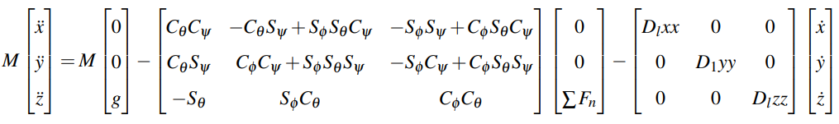
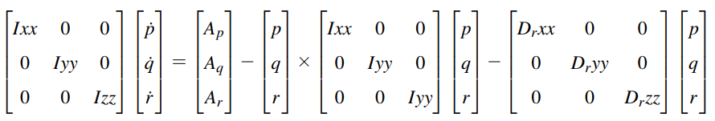
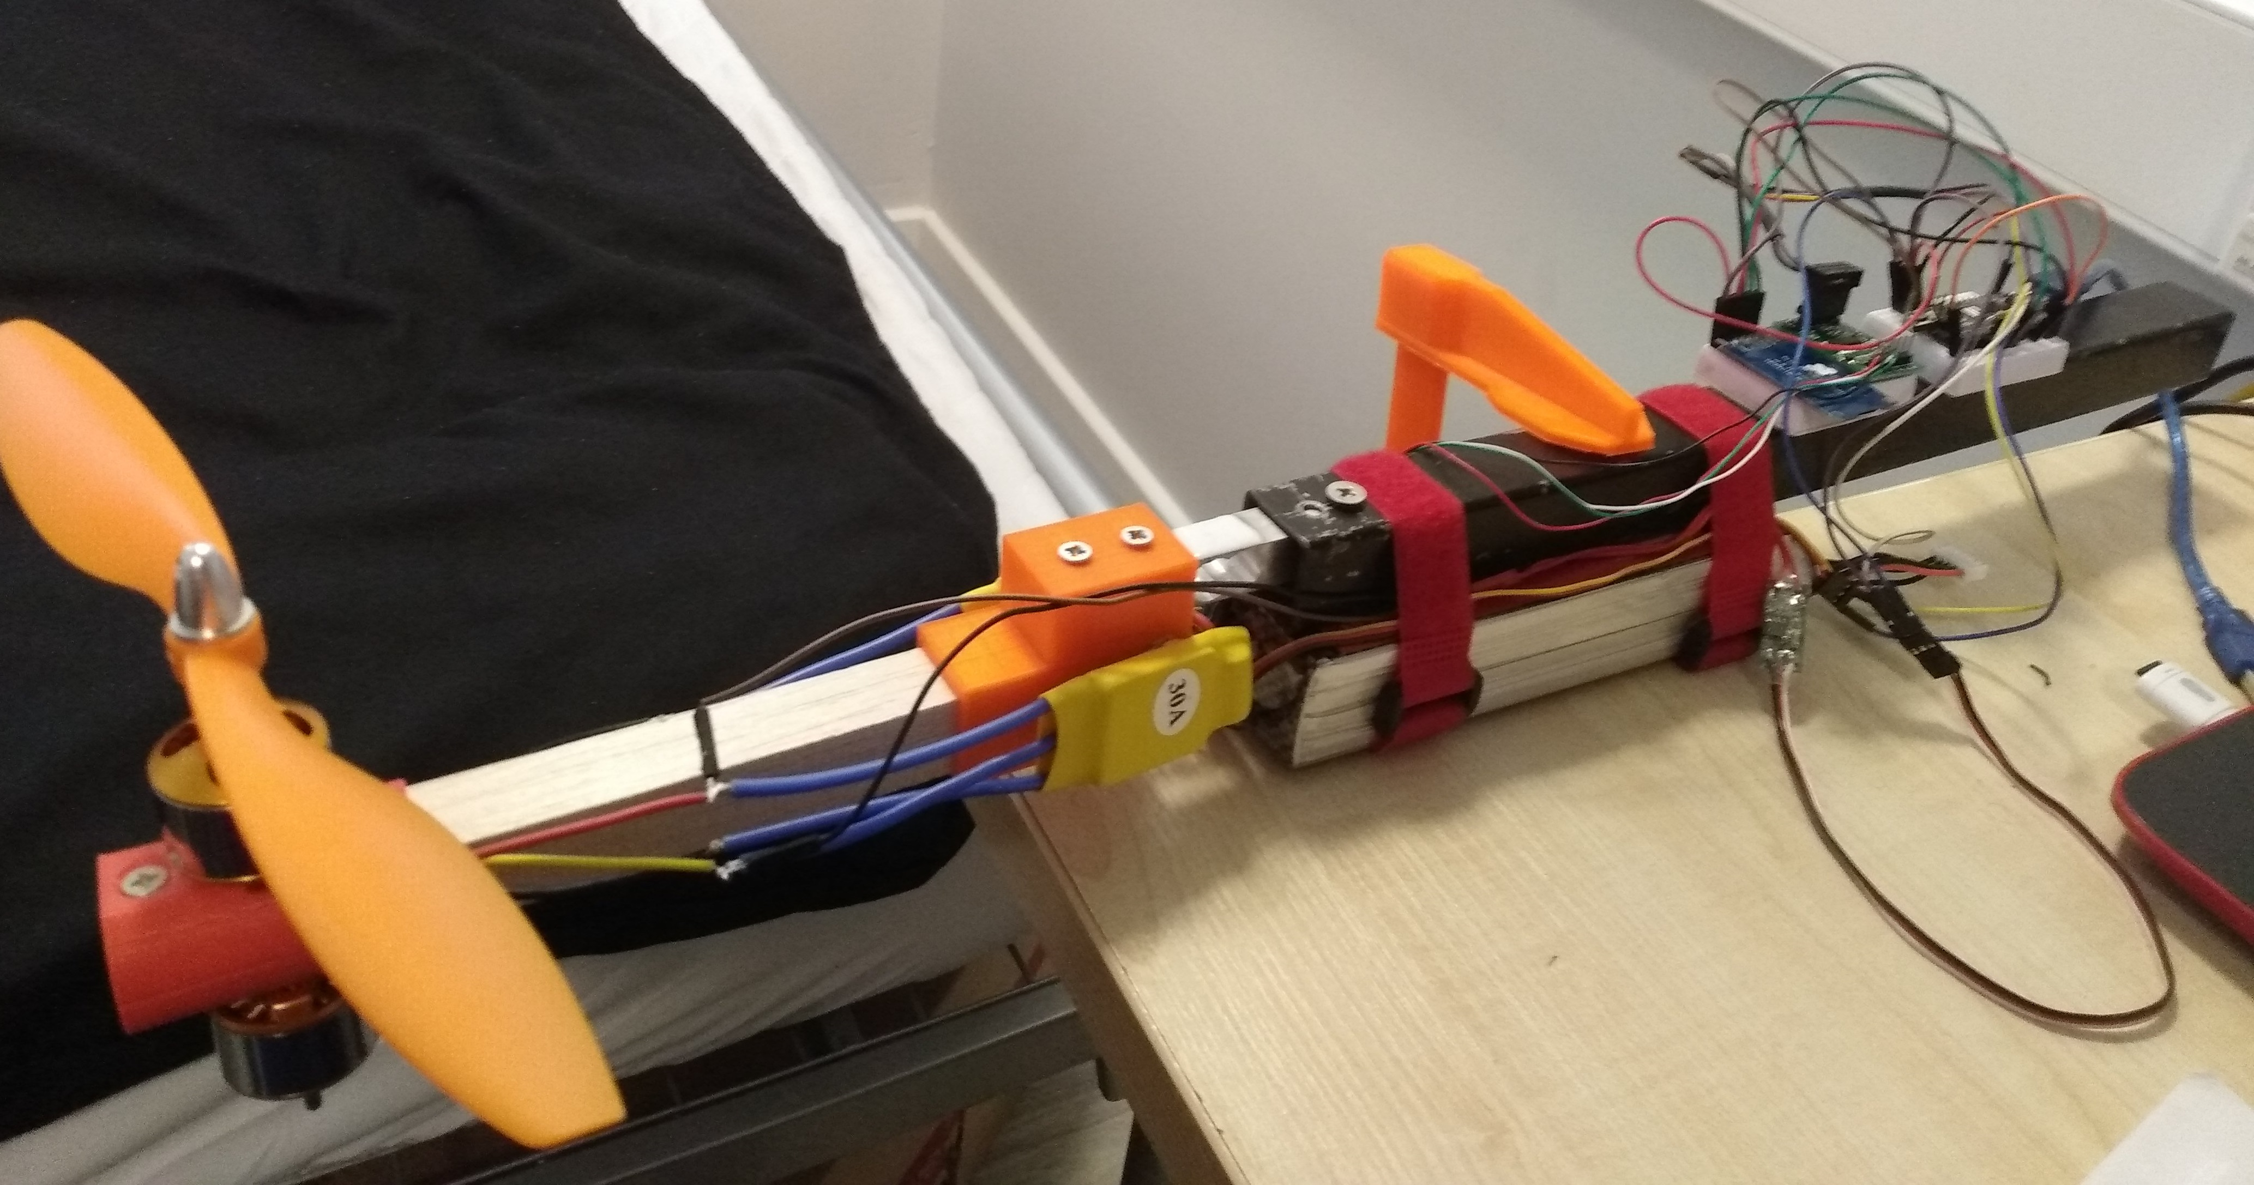
Modelling
Kinematics
Kinetics
Actuator Identification
Linearisation

Slide 6
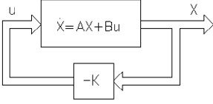
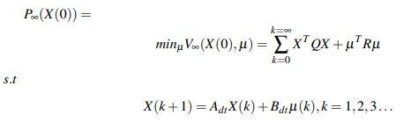
Linear Quadratic Regulator
Discretisation
Stability
Reachability
Full-State Feedback
Optimisation

Slide 7
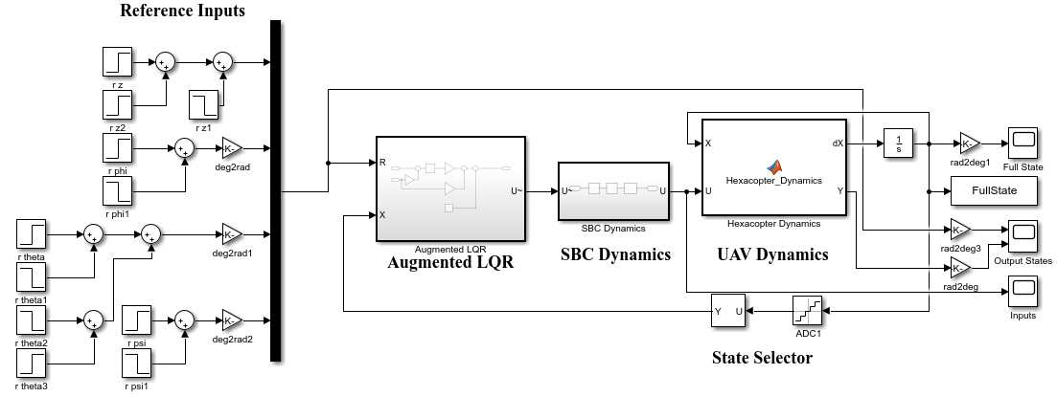
LQR Simulation

Slide 8
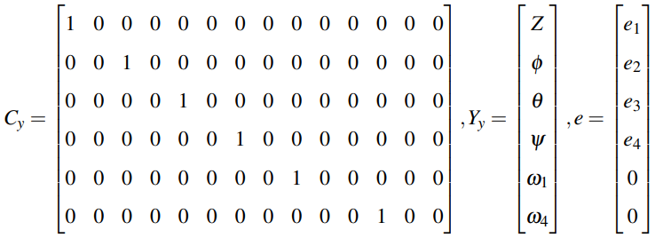
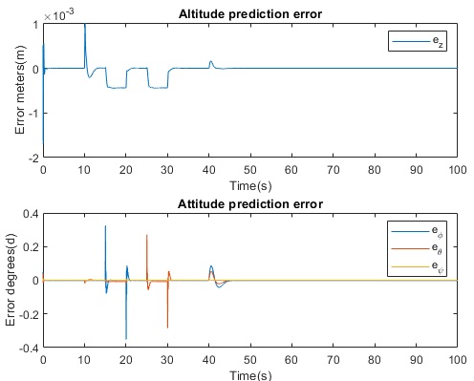
Modified State Estimation
LQR assumes full state
State estimation required
However, system not observable due to motor configuration
Virtual motor observations assuming no error
Modified EKF using linear estimator gain

Slide 9
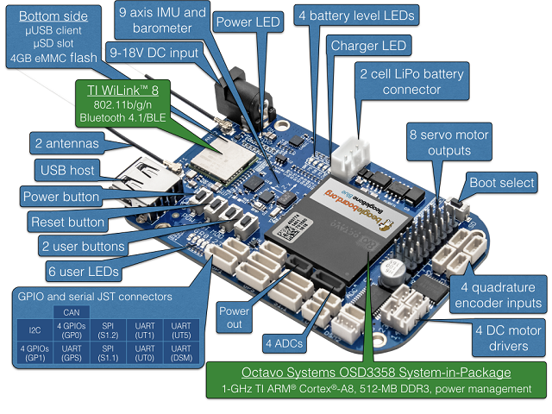
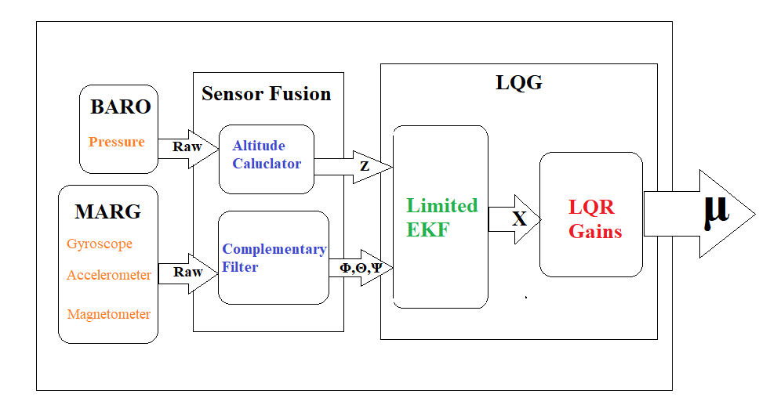
Embedded Microprocessor
Beagle Bone Blue Single Board Computer (SBC)
Robot Control Library
Proposed Embedded System

Slide 10
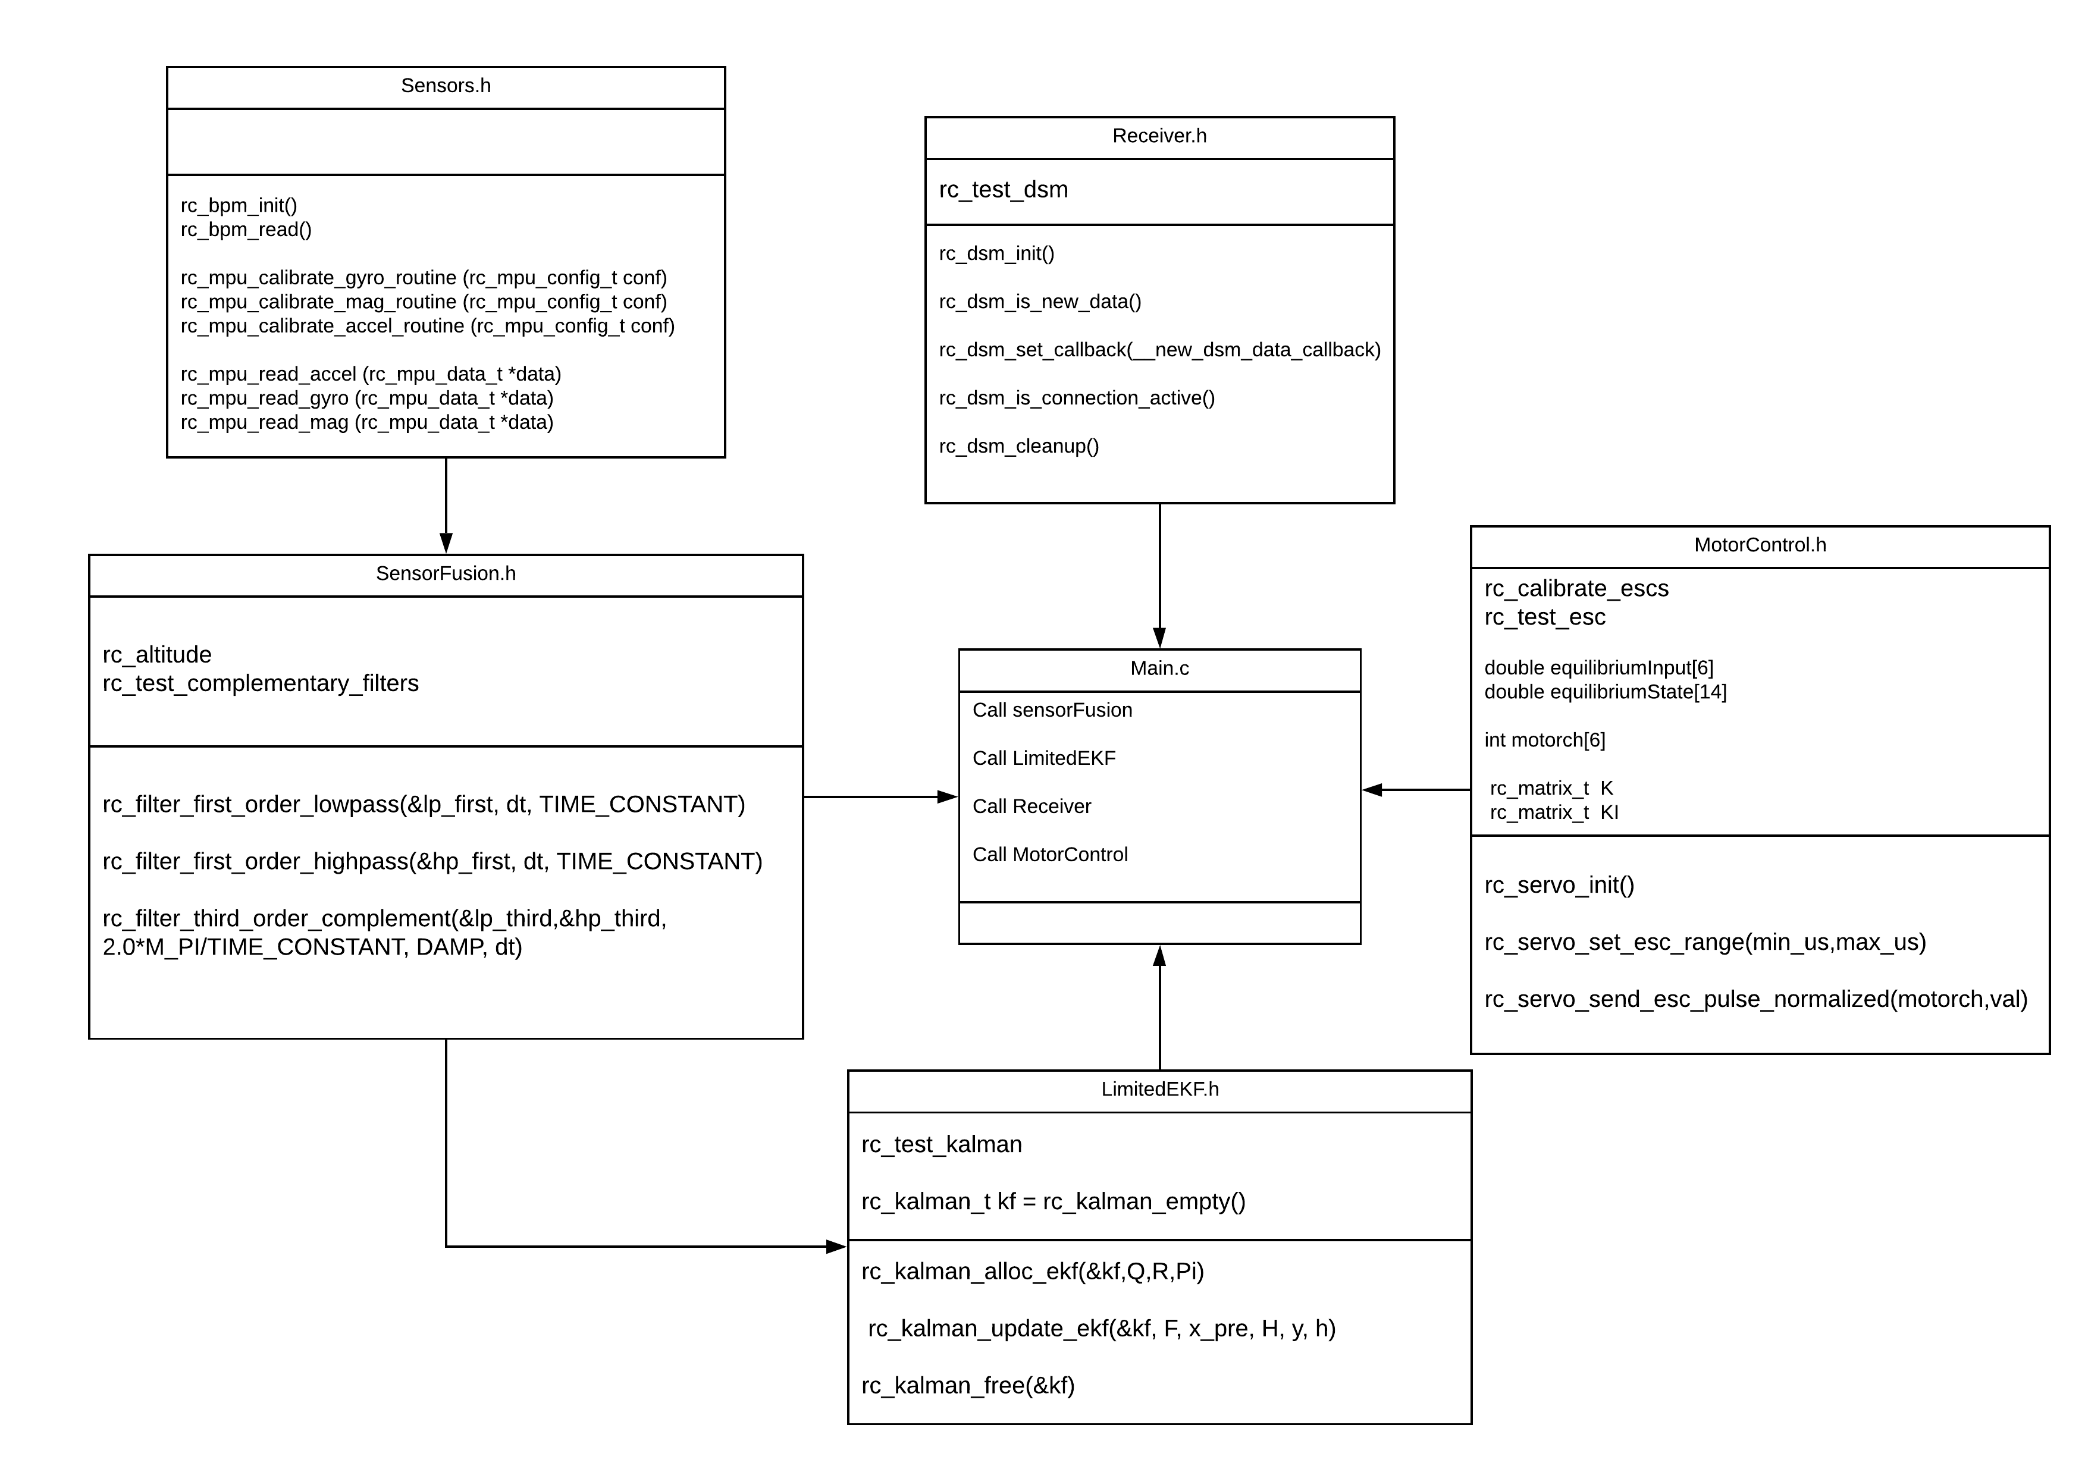
UML

Slide 11
Advanced Objectives

Slide 12
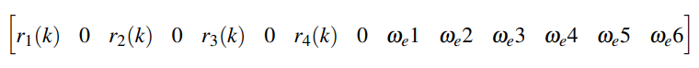
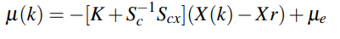
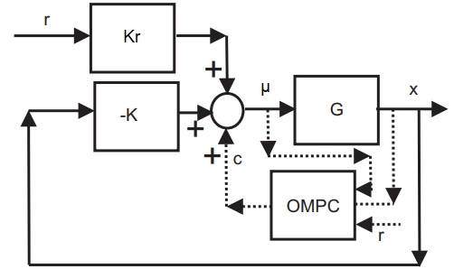
Linear Quadratic Model Predictive Control
Prediction
Optimisation
Receding Horizon
Constraints
Dual Mode MPC
Terminal cost derived from stabilising LQR gains
Closed-loop solves ill-conditioning
LQ-MPC/OMPC

Slide 13
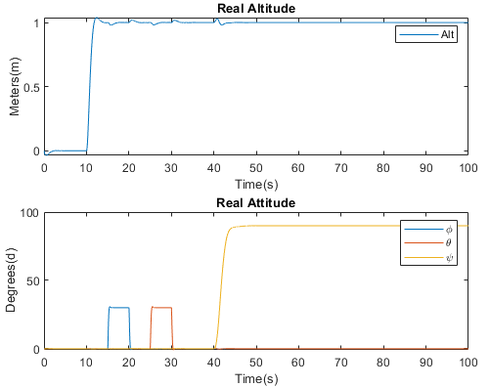
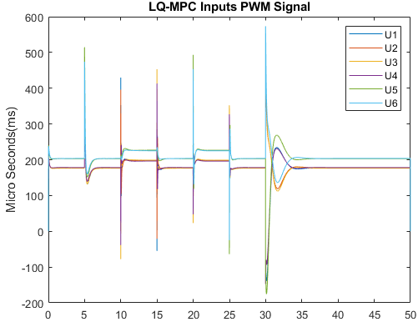
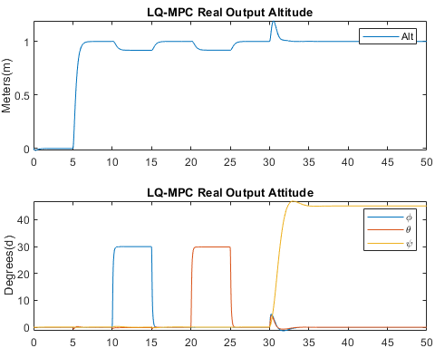
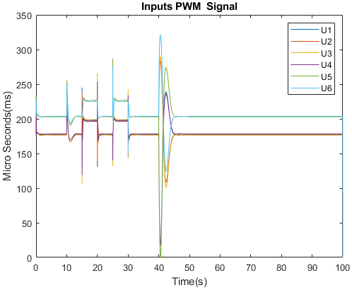
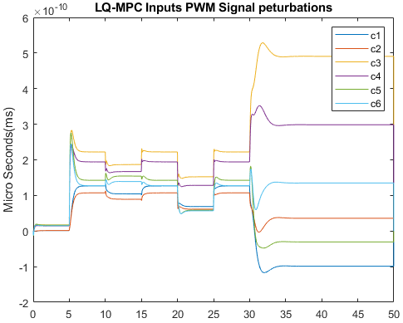
Results
LQG
Unconstrained LQ-MPC

Slide 14
Future Work
Constrained LQ-MPC
Implement proposed software
Remodel using quaternions
Non-linear Control
Add full control authority

